Slide 1

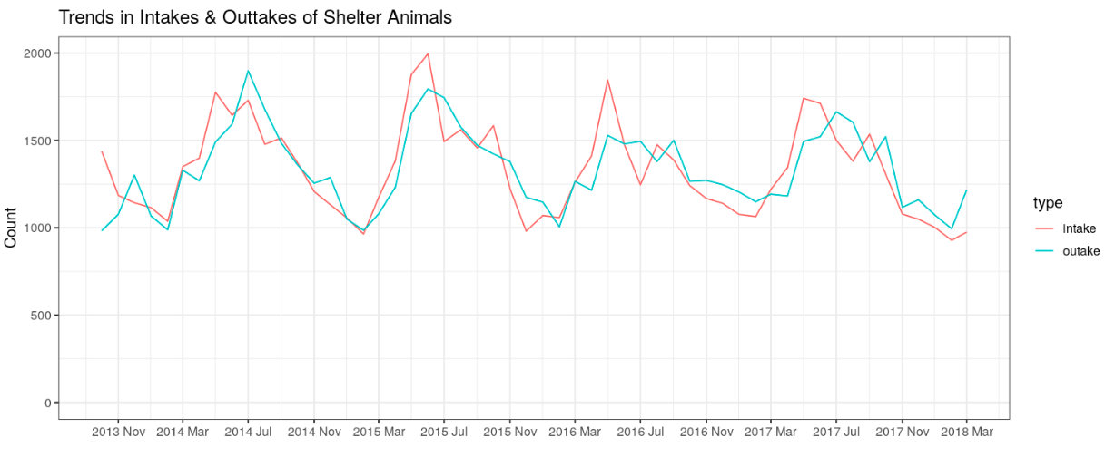
This project is targeted at Austin Animal Center staff and volunteers for their operational planning and budgeting.
For more information, please go to http://www.austintexas.gov/department/aac
Select Intake Year Data for All Plots:
2013
2014
2015
2016
2017
2018
2019
Slider to provide common filter to all graphs on year

Slide 2
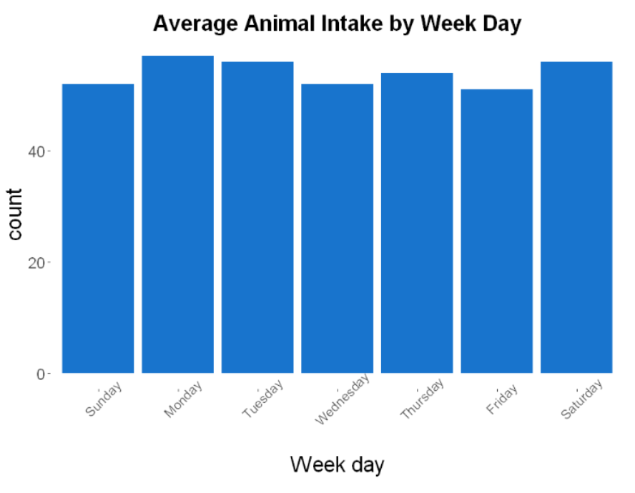
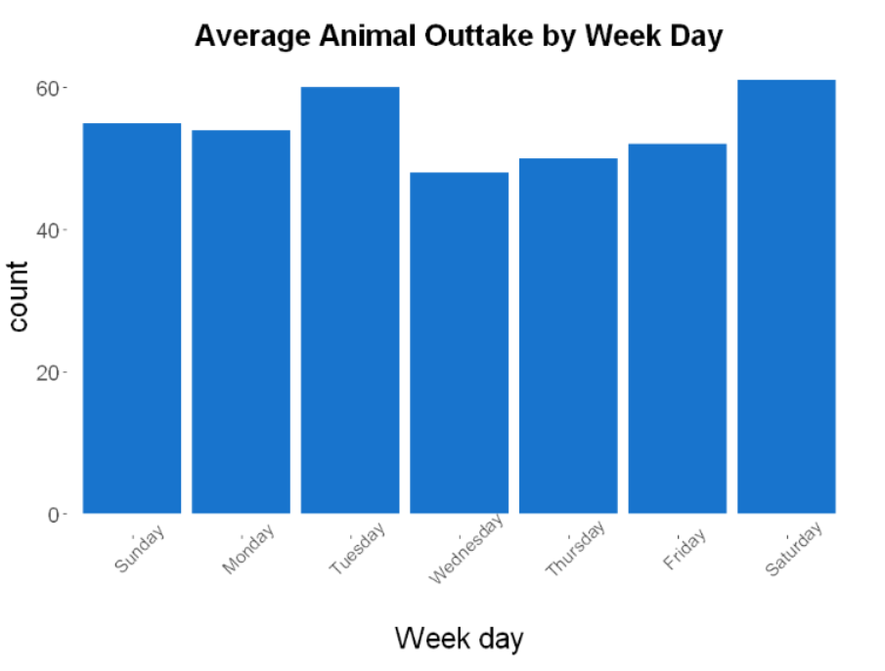

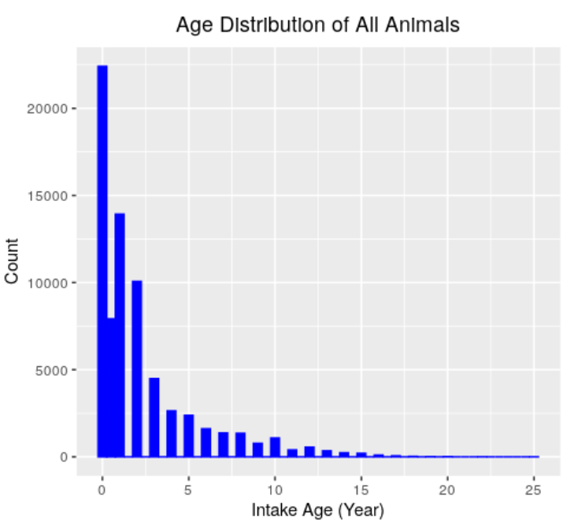
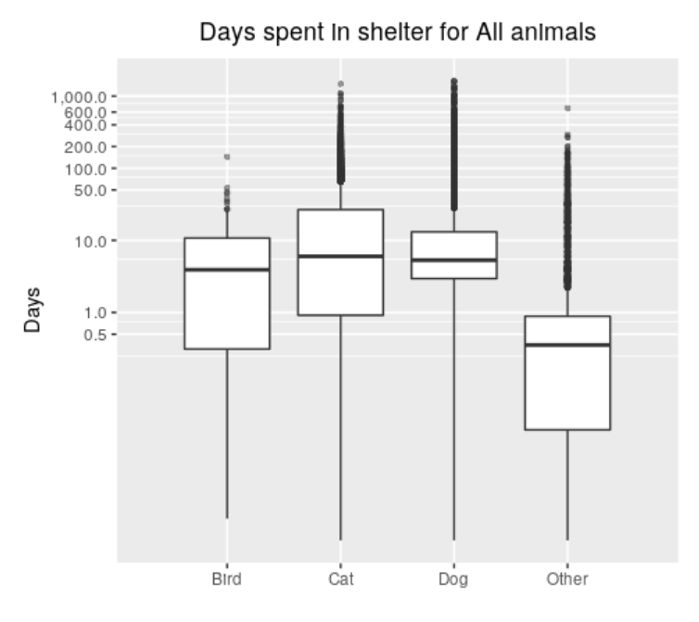


Select Month
Select Animal
All
All
January
February
March
April
Dog
Cat
Bird
Other
Combined month and animal droplist selection for plots 2 and 3
Animal Type
Select Intake
Health Condition
All
Dog
All
Cat
Healthy
Sick
Aged
Injured
Pregnant
Feral
Bird
Other
Radio Button to change option for animal type of left plot
Drop list selection for intake health conditions

Slide 3
R Dash Progress Sketch

Slide 4
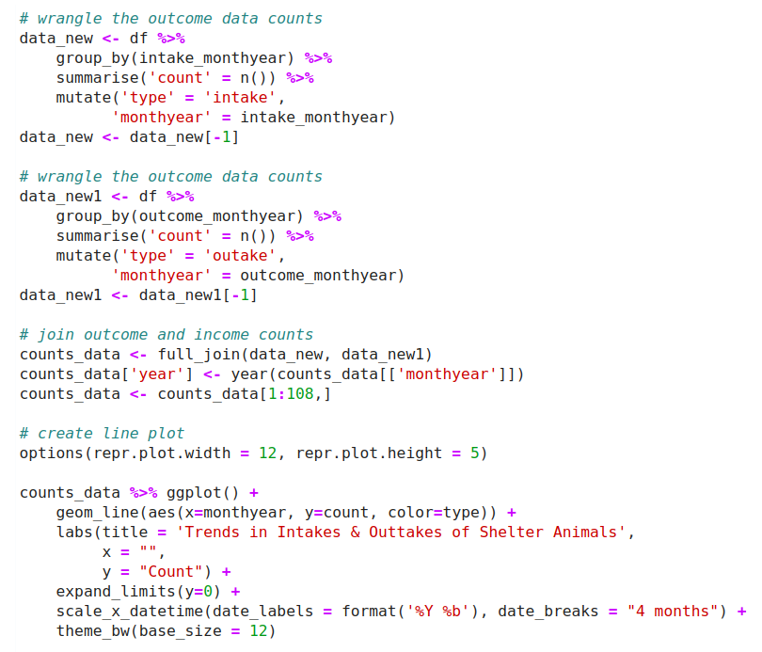
Plot1

Slide 5
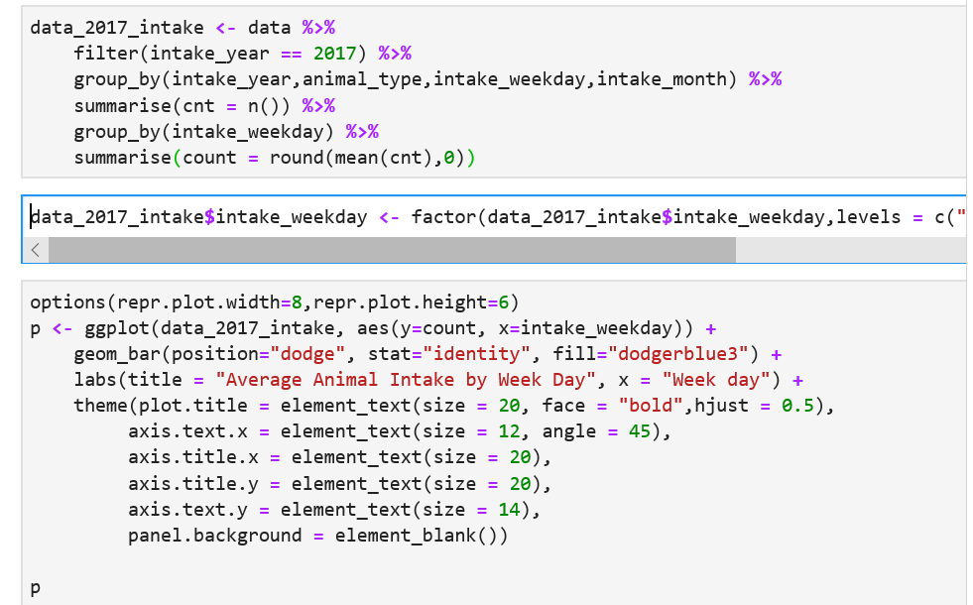
Plot 2

Slide 6
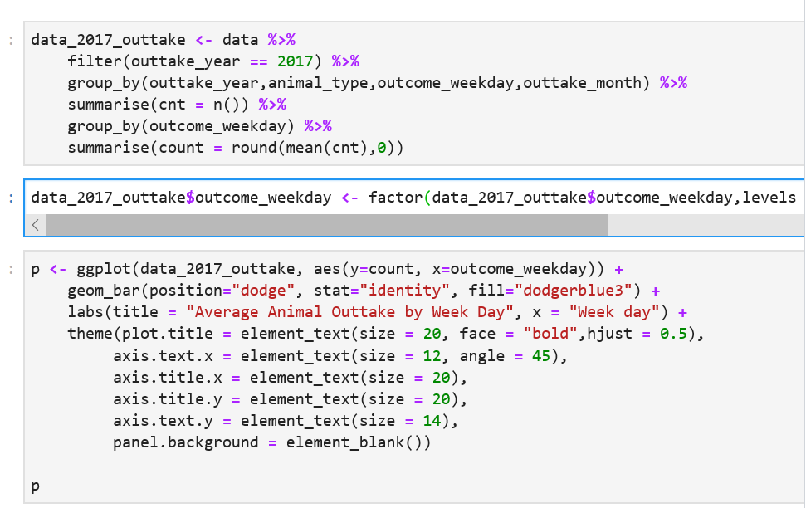
Plot 3

Slide 7
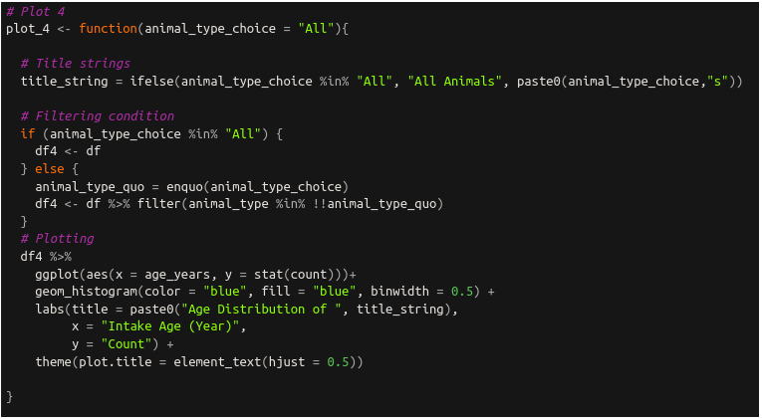
Plot 4

Slide 8
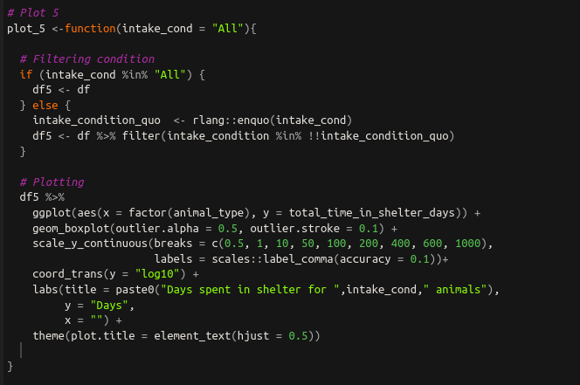
Plot 5

